Slide 1
IoT Based Weather and Air Quality Monitoring System using ESP32 and Telegram Alerts

Slide 2
Team Members
NAME | REG NO
Aryan Nair | 24BDS0320
Prajith Senthil | 24BAI0304
Sakrit Kafle | 24BCE2952

Slide 3
Aim (Objective) of the project
The aim of this project is to design and implement an IoT‑based environmental monitoring system using ESP32 that measures temperature, humidity, air pressure and gas levels.
The system sends real‑time alerts and data to a Telegram bot through WiFi, allowing users to monitor environmental conditions remotely.
It also detects sudden spikes or dangerous gas levels and triggers warning alerts using LEDs and Telegram notifications.

Slide 4
Literature Survey
S.No | Paper Title | Name of the Conference/Journal, Year | Technology Used
1 | IoT Based Smart Air Quality Monitoring System | IEEE Sensors Journal, 2024 | IoT, ESP32, MQ Gas Sensors
2 | Real-Time Environmental Monitoring Using Wireless Sensor Networks | IEEE International Conference on IoT, 2023 | Wireless Sensors, IoT, Cloud
3 | Smart Weather Monitoring System Using IoT | International Journal of Engineering Research & Technology, 2024 | Arduino/ESP32, DHT Sensors, WiFi
4 | Air Pollution Monitoring Using IoT and Gas Sensors | Springer Environmental Monitoring Journal, 2023 | MQ135 Sensor, Microcontroller, IoT
5 | Design of IoT-Based Weather Station for Environmental Monitoring | IEEE Access, 2022 | IoT, BMP Pressure Sensor, Microcontroller
6 | Smart Environmental Monitoring System for Urban Areas | ACM International Conference on Smart Cities, 2024 | IoT Sensors, Wireless Networks
7 | Low-Cost IoT System for Air Quality Monitoring | Elsevier Environmental Technology Journal, 2023 | ESP32, Gas Sensors, Cloud Monitoring
8 | Real-Time Weather Monitoring Using Embedded Systems | International Conference on Embedded Systems, 2022 | Embedded Systems, Sensors, WiFi
9 | IoT-Based Smart Pollution Monitoring and Alert System | IEEE International Conference on Smart Computing, 2024 | IoT, Gas Sensors, Mobile Alerts

Slide 5
Websites referred
1. https://randomnerdtutorials.com
2. https://arduino.cc
3. https://github.com
4. https://iotdesignpro.com
5. https://lastminuteengineers.com

Slide 6
Methodolgy/Block Diagram
1. ESP32 connects to WiFi network.
2. Sensors collect environmental data:
• DHT11 – Temperature & Humidity
• BMP085 – Pressure & Altitude
• MQ4 – Methane Gas
• MQ135 – Air Quality
3. ESP32 processes sensor values and checks thresholds.
4. If abnormal values or sudden spikes are detected:
• Red LED turns ON
• Telegram alert is sent.
5. User can request live data using Telegram command (/data).

Slide 7
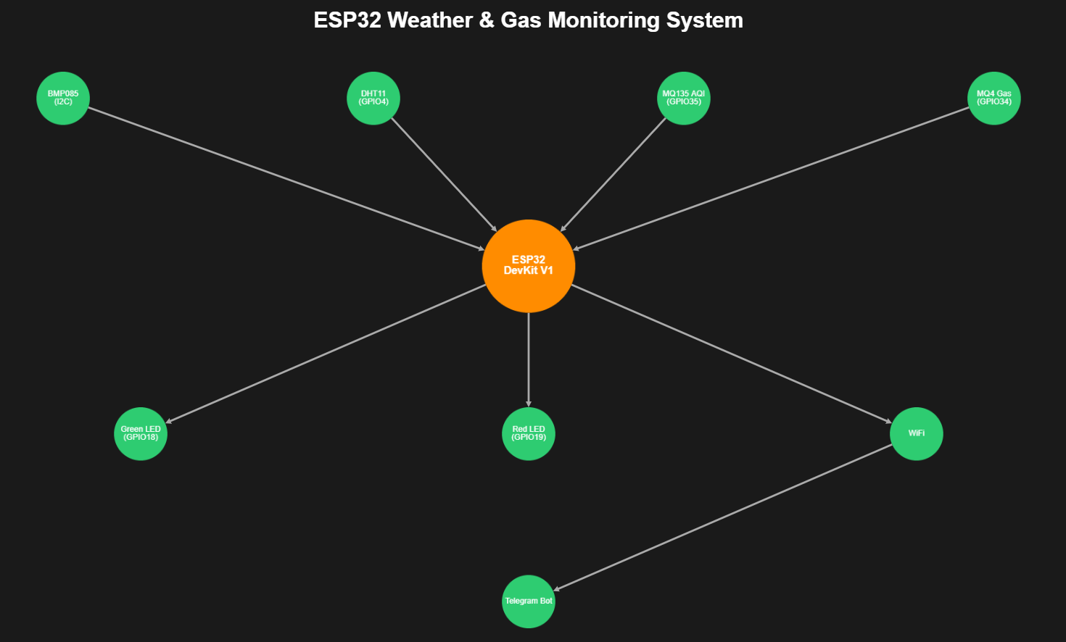
GY-68

Slide 8
Hardware components
Hardware Components:
ESP32 DevKit V1
MQ4 Gas Sensor
MQ135 Air Quality Sensor
DHT11 Temperature & Humidity Sensor
GY-68 Pressure Sensor
Red and Green LEDs
Jumper Wires
Breadboard

Slide 9
Software Details + algorithm/Alp flow chart
Software Tools:
• Arduino IDE
• ESP32 Board Package
• Telegram Bot API
• WiFi Library
• DHT Sensor Library
• Adafruit BMP085 Library
Algorithm:
1. Initialize sensors and WiFi connection.
2. Calibrate gas sensors.
3. Read sensor values periodically.
4. Compare readings with threshold values.
5. Detect sudden changes in temperature, pressure or gas.
6. Send alerts through Telegram.
7. Respond to user command /data to send current readings.

Slide 10
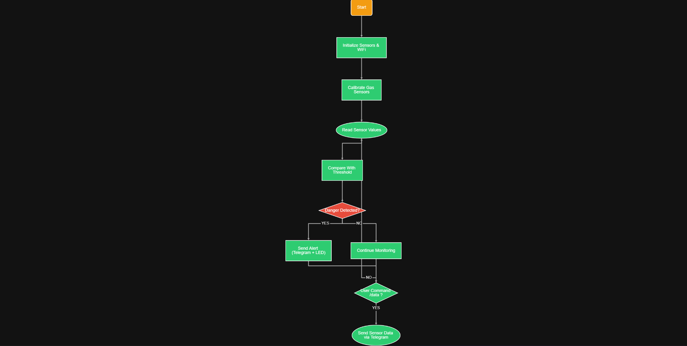

Slide 11
Work completed so far
ESP32 hardware setup completed.
Sensors successfully interfaced.
WiFi connectivity established.
Telegram bot integrated.
Real‑time sensor readings implemented.
LED alert system working.
Sudden spike detection algorithm implemented.

Slide 12
Images of the code and results
Images include:
• ESP32 circuit setup
• Code implementation in Arduino IDE
• Telegram bot alert messages

Slide 13
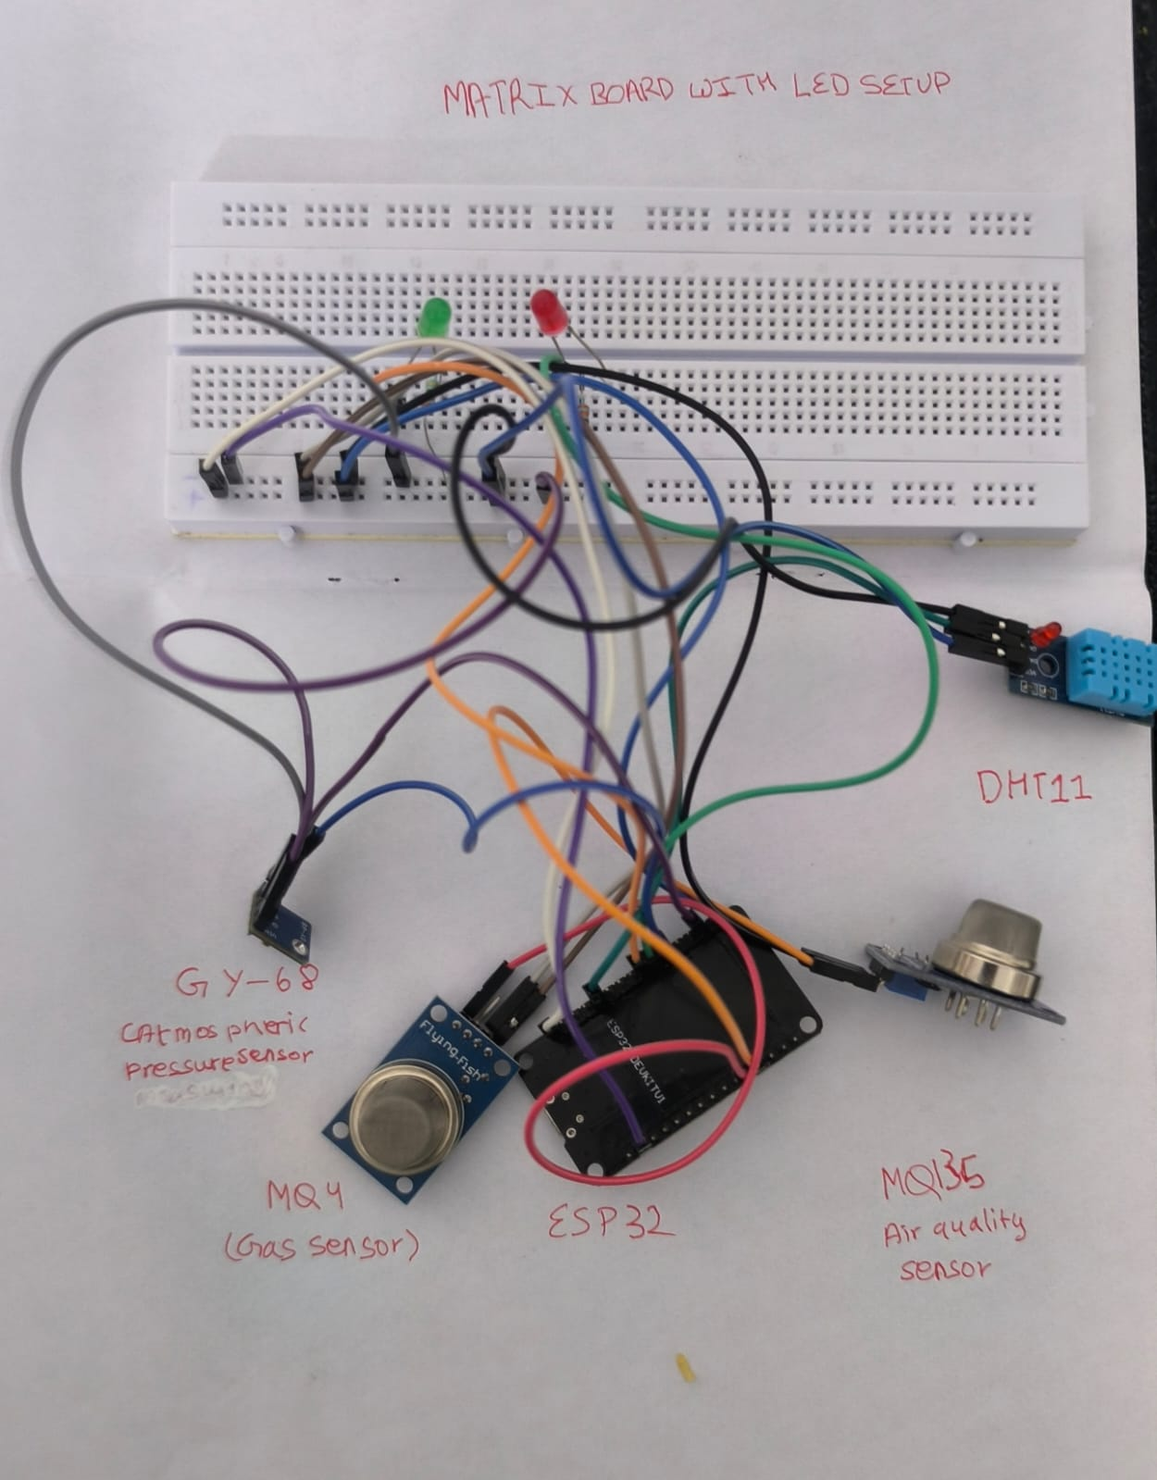

Slide 14
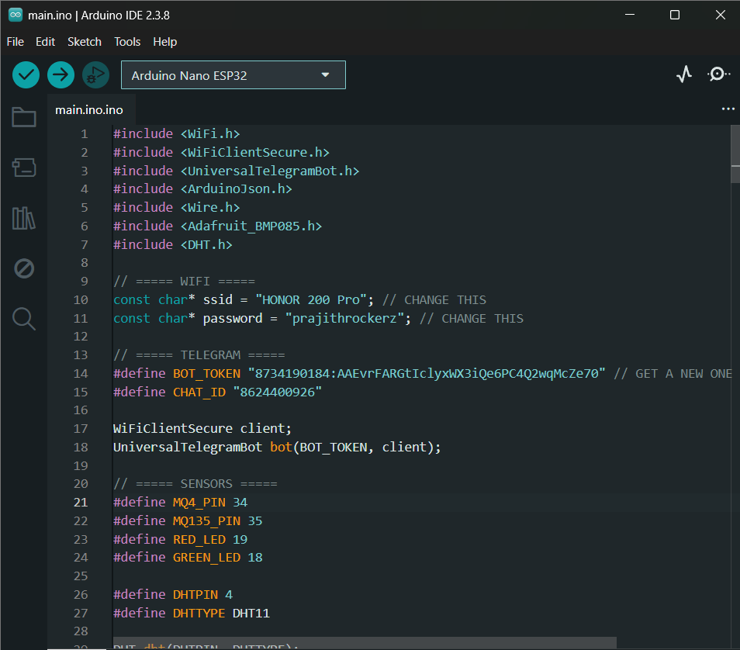
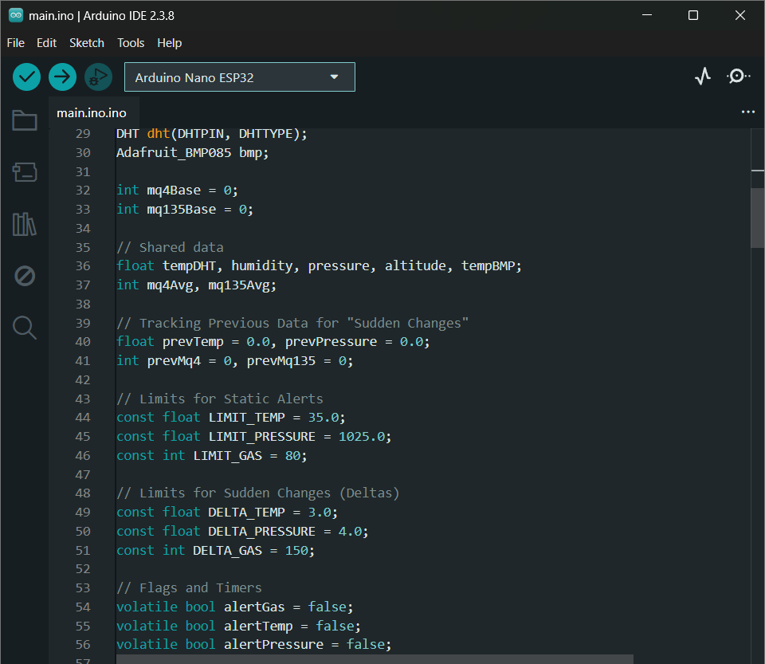
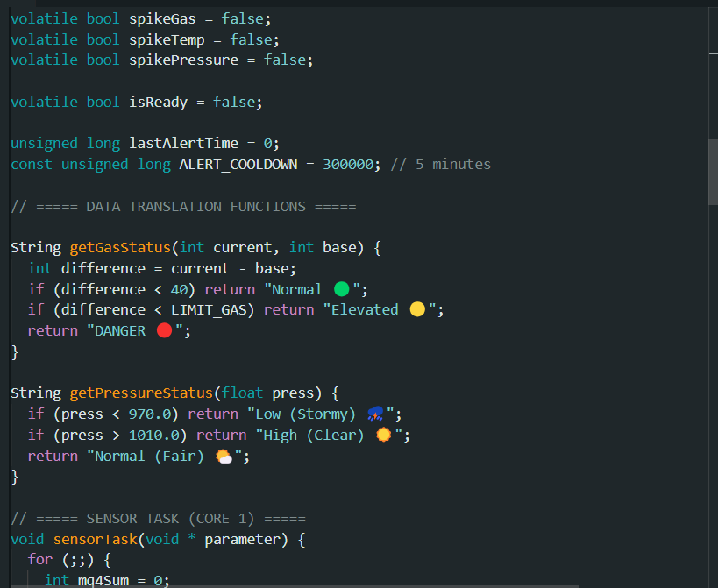
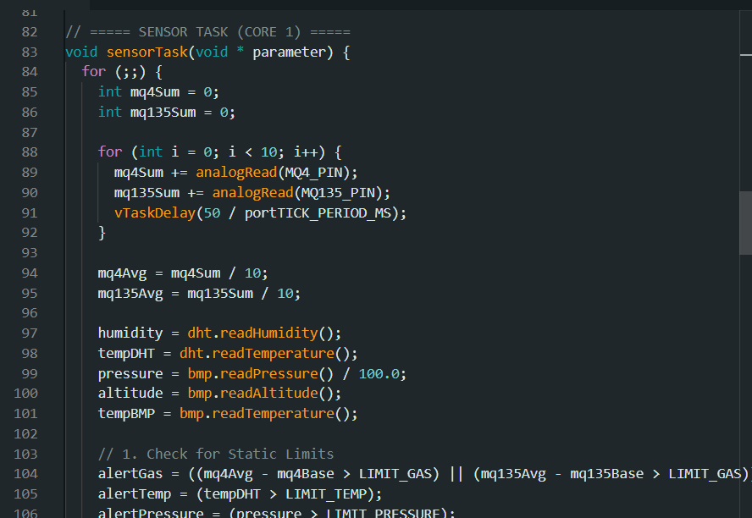
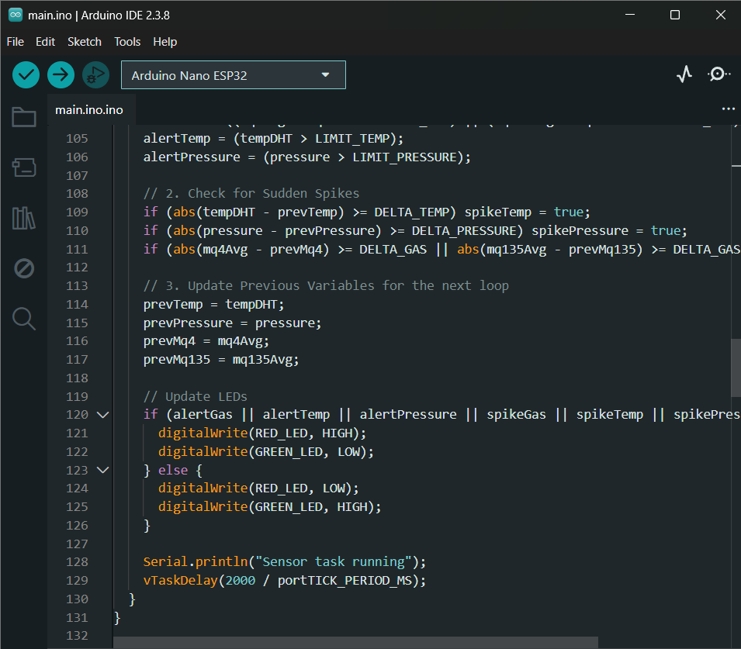
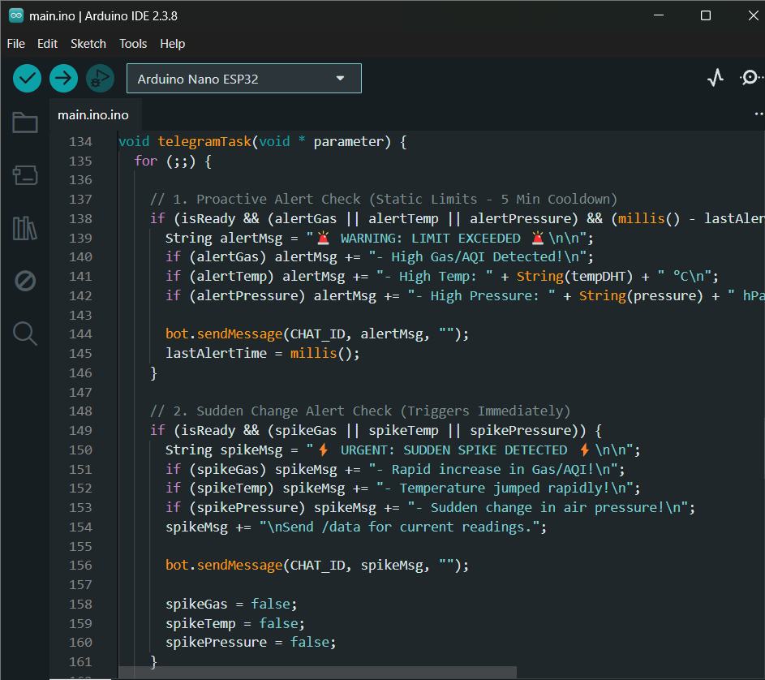

Slide 15
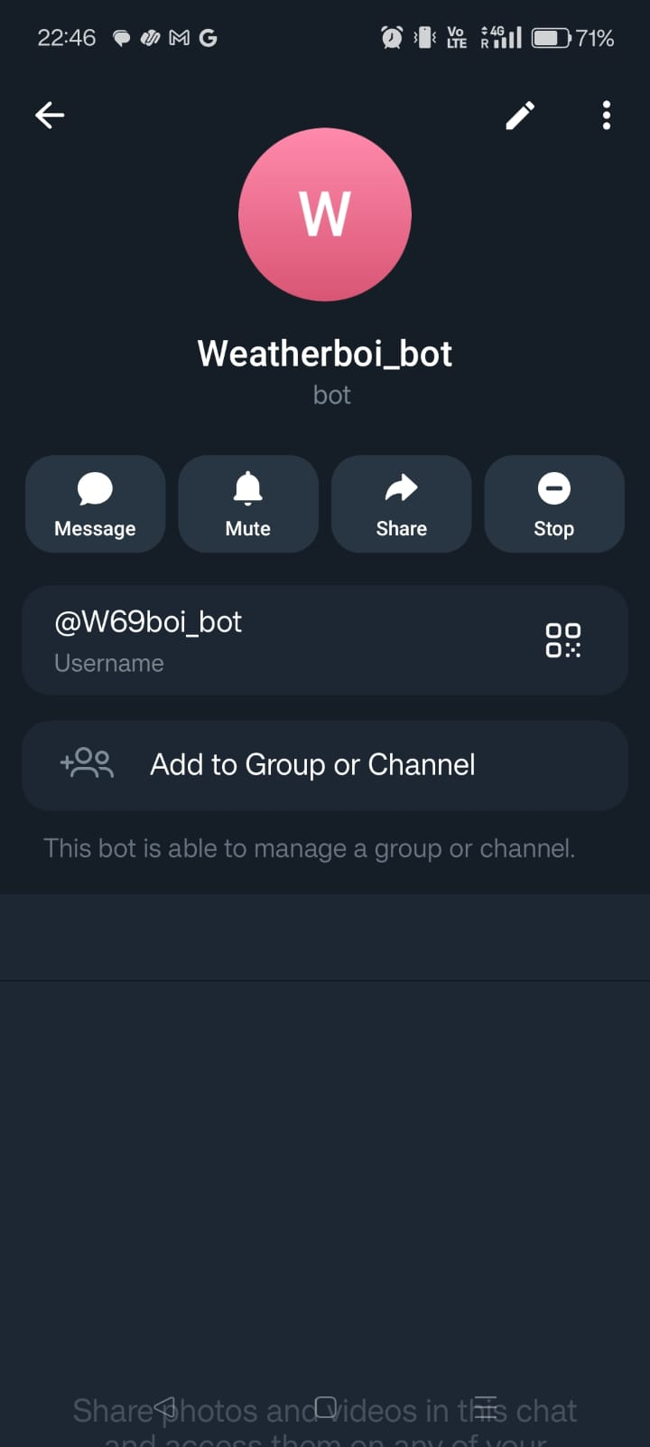
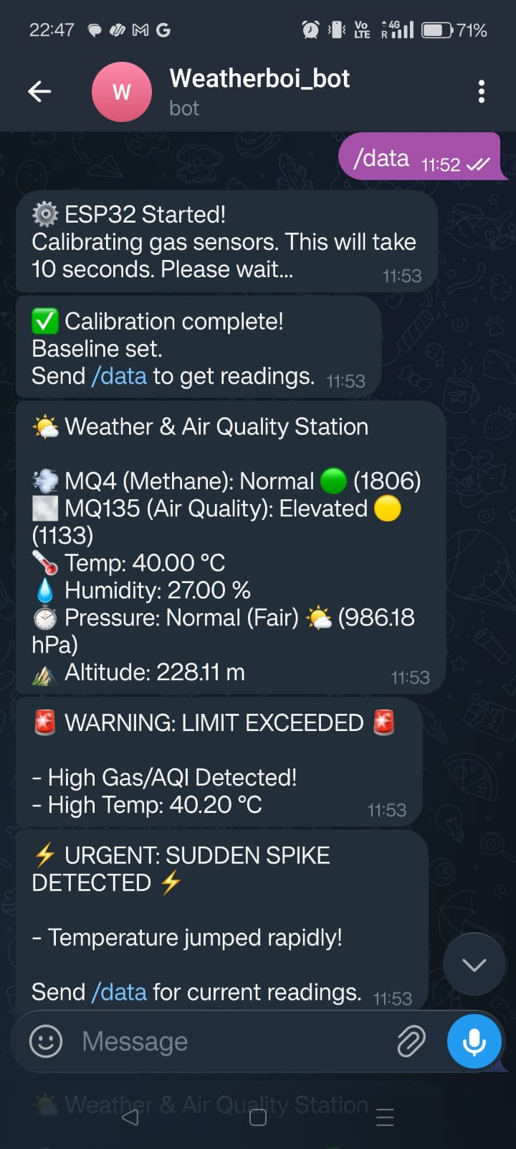
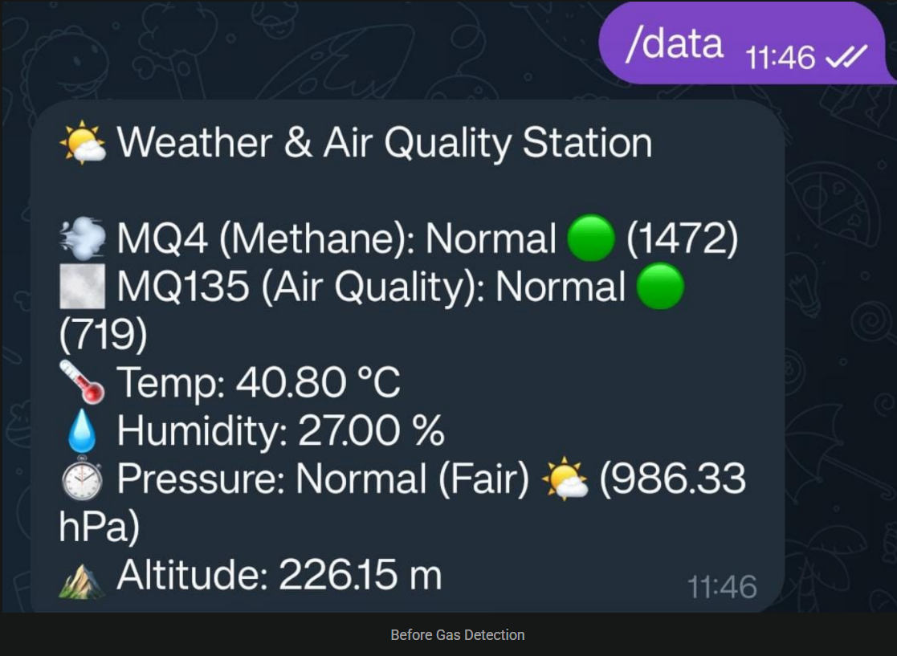

Slide 16
Work to be completed ( after review-2)
• Make led lights functional
• Improve accuracy of gas sensor calibration.
• Implement data logging to cloud server.
• Optimize power consumption of system.

Slide 17
Cost analysis(for hardware experiments)
Estimated Cost:
ESP32 DevKit V1 – ₹450
MQ4 Gas Sensor – ₹200
MQ135 Sensor – ₹200
DHT11 Sensor – ₹120
BMP085 Sensor – ₹180
LEDs + Resistors – ₹30
Jumper wires & Breadboard – ₹150
Total Estimated Cost ≈ ₹1330

Slide 18
Abstract
Air pollution and sudden environmental changes create dangerous threats which can harm human health and safety. The project demonstrates an IoT-based system which monitors air quality and weather conditions through an ESP32 Devkit V1. The system uses DHT11 Temperature and Humidity Sensor and MQ-4 Gas Sensor and MQ-135 Gas Sensor and BMP085 Barometric Pressure Sensor to collect environmental data about temperature and humidity and air pressure and gas concentration.
The ESP32 processes sensor data to identify both normal conditions and sudden changes that surpass established limit points. The system sends alerts together with live data to users through a Telegram bot which operates using Wi-Fi connections. The system delivers an affordable solution which enables users to monitor environmental conditions in real time and receive remote alerts.

Slide 19
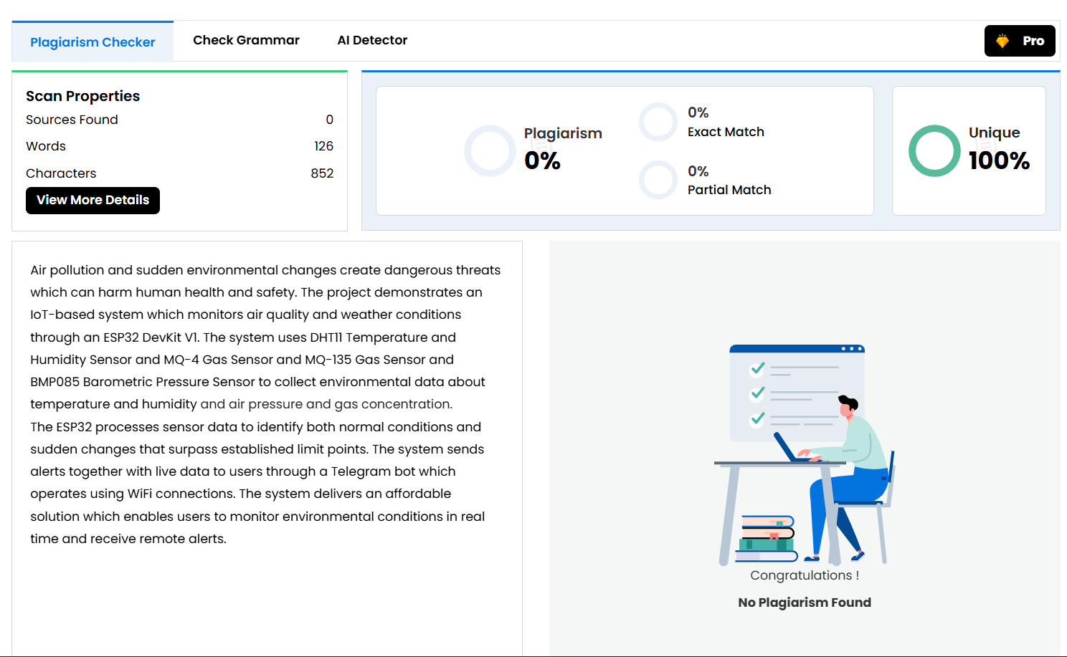
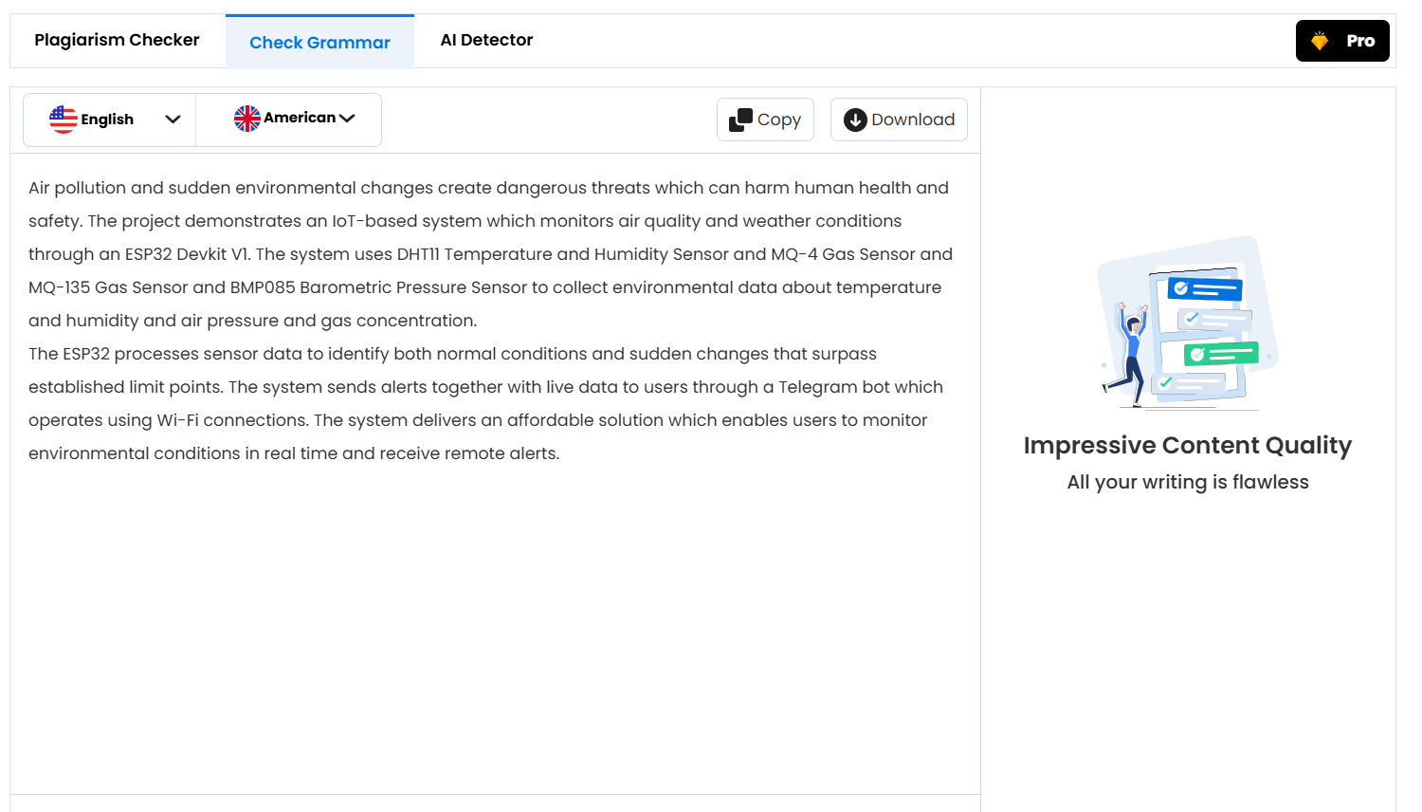
Plagiarism report for Abstract

